Slide 1
Drug & Alcohol Testing
PayneWest Insurance
Loss Control
Presentation by: Brendan Riley

Slide 2
RESOURCES

Slide 3
RESOURCES

Slide 4
RESOURCES

Slide 5
RESOURCES

Slide 6
RESOURCES

Slide 7
RESOURCES

Slide 8
RESOURCES

Slide 9
RESOURCES
Loss control

Slide 10
Drug & Alcohol Testing
Employee Education Policy
Recordkeeping
Supervisor Training
Managing Results
Appropriate Testing
DOT Required Forms

Slide 11
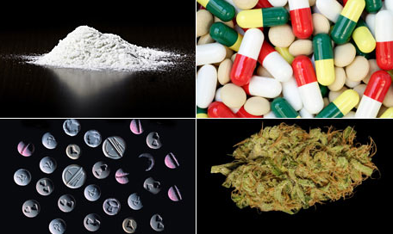
DOT Drug & Alcohol Testing Policy and Driver Education
Regulations in General
Who
What
When
Why
Company Policy and Procedures
Designated Employer Representative
Consequences for Violating Policy

Slide 12
Supervisor Training

Slide 13
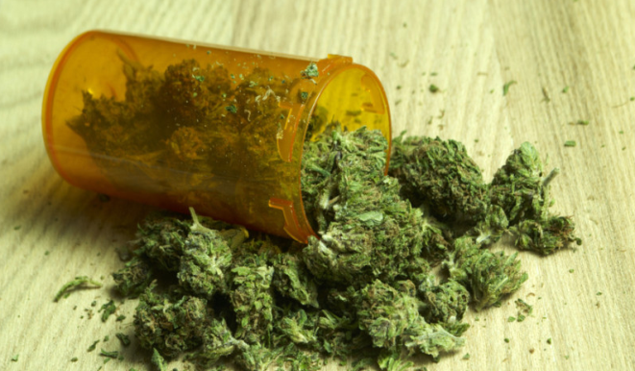
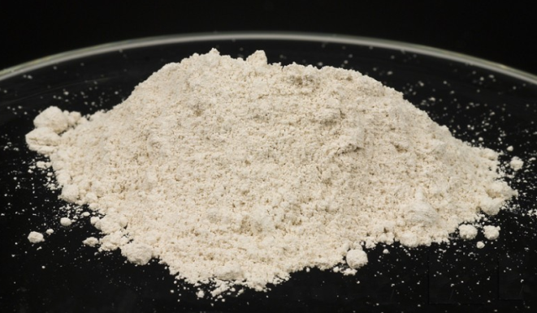
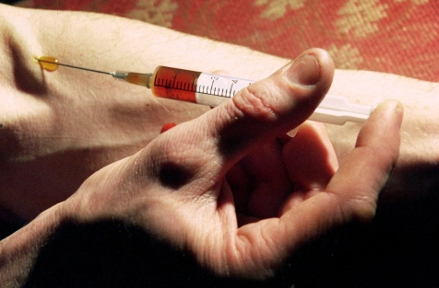
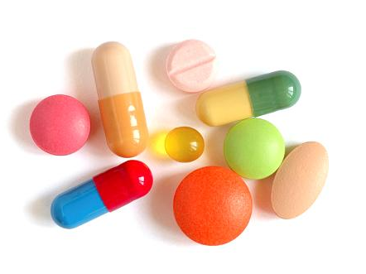
DOT Required Drug Testing
Marijuana
PCP
Opiates
Amphetamines
Cocaine

Slide 14
Drug & Alcohol Testing
Pre-Employment
Follow Up
Post Accident
Return to Duty
Random
Reasonable Suspicion

Slide 15
Federal Drug Testing Form

Slide 16
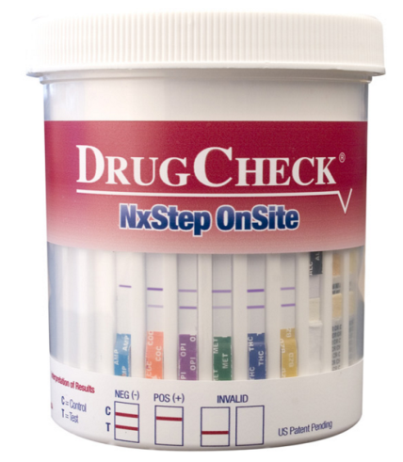
Presents for Testing
Urine Sample Collected
Tested by Approved Lab
Test Result Released by MRO
Confirms Information
Orders Additional Testing or Exam
NON-NEGATIVE
NEGATIVE
Releases Verified Result
Confidential Interview

Slide 17
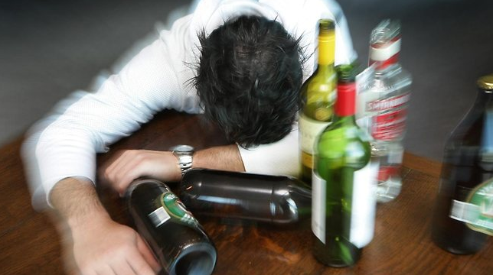
Alcohol Testing
Alcohol is legal
Just before safety sensitive
Just after safety sensitive
While performing safety sensitive

Slide 18
Alcohol Testing
2 hour time limit
Can be extended up to 8 hours
After 8 hours must stop all attempts

Slide 19
Alcohol Testing
Pre-Employment
Follow Up
Post Accident
Return to Duty
Random
Reasonable Suspicion

Slide 20
Federal Alcohol Testing Form

Slide 21
Positive or Refusal
Verified Positive Refusal
Return to Duty
Follow Up
Removed Safety Function
Treatment Education
Employer’s Obligation Provide SAP
Substance Abuse Professional

Slide 22
COMMON MISTAKES
USING NON-DOT FORMS
TESTING NON-CDL REQUIRED DRIVERS
IMPROPER RECORDKEEPING
RANDOM CONSORTIUM MANAGEMENT
POSITIVE/REFUSAL TEST RESULT MANAGEMENT

Slide 23
THANK YOU!
Loss control

