Slide 1
Hours of Service
PayneWest Insurance
Loss Control
Presentation by: Brendan Riley

Slide 2
RESOURCES

Slide 3
RESOURCES

Slide 4
RESOURCES

Slide 5
RESOURCES

Slide 6
RESOURCES

Slide 7
RESOURCES
Loss control

Slide 8
HOURS OF SERVICE
Recordkeeping
Record of Duty Status
Daily Driver’s Limit
34 Hour Restart
Daily Duty Limit
Weekly Duty Limit

Slide 9
Daily Limits
10 Consecutive Hours of REST
14 Hour Duty Window
May Drive 11 Hours
30 Minute Break
10/14/11

Slide 10
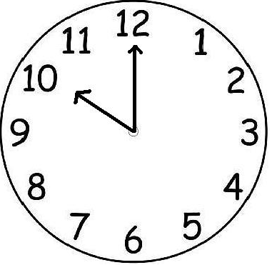
Daily Limits 10 Hours Rest
10 CONSECUTIVE Hours of Rest

Slide 11
Daily Limits 14 Hour Limit
Work at 6:00 AM?
08:00 PM – NO MORE DRIVING

Slide 12
Daily Limits 11 HOUR Driving
YOU NEED
10 HOURS
OF REST
OF 14 HOUR DUTY WINDOW
MAY DRIVE 11 HOURS
11 HOURS

Slide 13
30 MINUTE BREAK
Beginning July 1, 2013
CANNOT DRIVE MORE THAN 8 HOURS WITHOUT A 30 MINUTE BREAK
Can be On-Duty not driving, but not driving
Can be Off-Duty or Sleeper Berth
COUNTS AGAINST YOUR 14 HOUR CLOCK

Slide 14
DAILY LIMITS
10 CONSECUTIVE HOURS OF REST
14 HOUR DUTY PERIOD
DRIVE 11 HOURS
30 MINUTE BREAK

Slide 15
WEEKLY LIMIT
60/70 HOUR RULE
Operate less than 7 days a week
A driver may not drive after having been on duty for 60 hours during any 7 days

Slide 16
WEEKLY LIMIT
60/70 HOUR RULE
Operates vehicles 7 days a week
A driver may not drive after having been on duty for 70 hours during any 8 consecutive days

Slide 17
WEEKLY LIMIT 60/70 HOUR RULE
Rolling Total
Based “On-Duty Time”
All time working – including 2nd jobs

Slide 18
WEEKLY LIMIT 60/70 HOUR RULE
Company operates 7 days a week – 70 hours
8 consecutive days
1-Jan 8
2-Jan 10
3-Jan 7
4-Jan 8
5-Jan 10
6-Jan 10
7-Jan 8
8-Jan
Total 61

Slide 19
34 HOUR RE-START
34 Hours of Consecutive Off-Duty Time
RE-SET 60/70 HOUR
MOVES BEGINNING CALCULATION POINT

Slide 20
WEEKLY LIMIT 34 HOUR RE-SET
1-Jan 12
2-Jan 14
3-Jan 14
4-Jan 0
5-Jan 0
6-Jan 14
7-Jan 14
8-Jan 14
Total 42

Slide 21
Review
10 Consecutive Hours of Rest
14 Hour Duty Period
Drive 11 Hours
30 Minute Break
60/70 Hours in 7/8 Days
34 Hour Re-Set

Slide 22
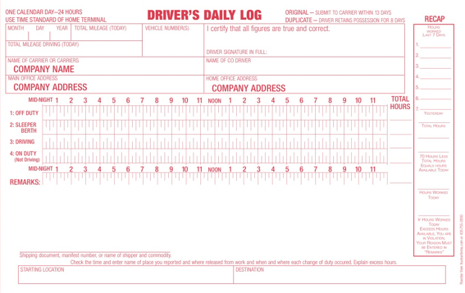
GENERAL REQUIREMENTS
Must be accurate reflection of driver’s day
Every day must be accounted for on log
Must submit original log sheet – 13 DAYS
Drivers must always have 8 days logs
Log must be current to last change of duty
ALL TIME COUNTS

Slide 24
EXCEPTIONS
100 Air Mile Radius
150 Air Mile Radius
Adverse Driving Conditions
Agricultural Operations
Alaska
Construction Materials & Equipment
Emergency Relief
Federal Government Operated
Fire and Rescue
Hawaii
Local Government Operated
Oilfield Operations
And More….

Slide 25
Common Mistakes
Falsifying Logs
Not keeping Log current
Not reviewing driver log for accuracy
No disciplinary consequences

Slide 26
THANK YOU!
Loss control

